Slide 1
Image Scraping and Classification Project
By
Manish Kumar

Slide 2
Problem Statement
Images are one of the major sources of data in the field of data science and AI. This field is making appropriate use of information that can be gathered through images by examining its features and details.
The idea behind this project is to build a deep learning-based Image Classification model on images that will be scraped from e-commerce portals. This is done to make the model more and more robust.

Slide 3
Business Goal
The idea behind this project is to build a deep learning-based Image Classification model on images that will be scraped from e-commerce portals.

Slide 4
About Dataset
The data was collected from amazon.in from three different sections of clothing. These sections consisted of jeans, trousers and sarees. The data was in image image format (jpeg) and was collected with the help of browser automation with selenium and downloaded with the help of request and shuttle library.
There were 240 images of each categories, hence there were total 720 images.

Slide 5
Data Preprocessing
All the downloaded images were preprocessed with the help of keras image_dataset_from_directory, they were reshaped into 256*256 pixels and divided into different batches of size 16. We also implemented some data augmentations like flipping images vertically or horizontally or rotating images by certain degrees with the help of sequential.

Slide 6
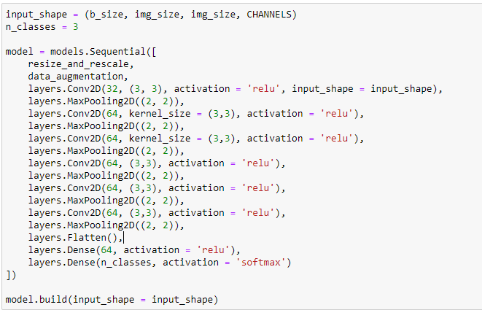
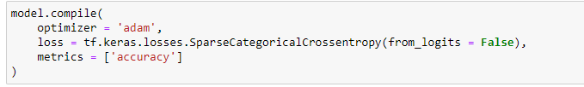
Model Building
We used convolutional neural networks (CNN) for building our deep learning model and our model consisted of 17 layers.
We used adam optimizer and accuracy as the evaluation metrics

Slide 7
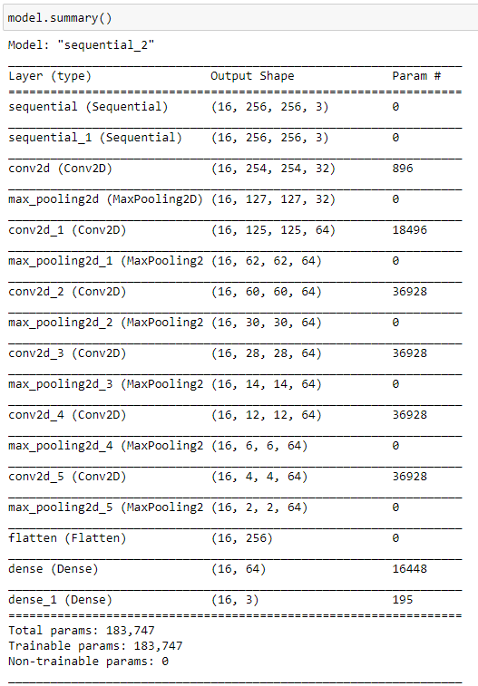
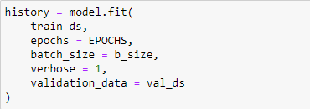
Continue...

Slide 8
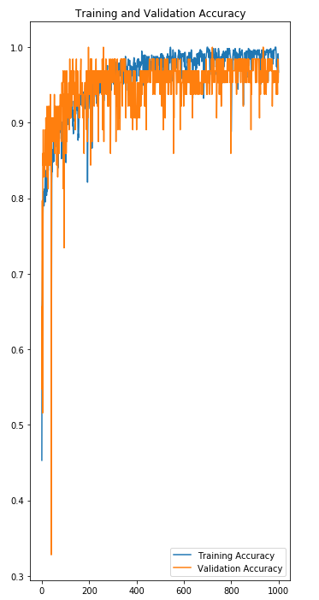
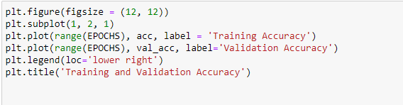
Accuracy
Initially I trained the model for 50 epochs and it gave accuracy around 86, then I increased the epochs to 100 and the accuracy also increased to 92 and finally I settled with 1000 epochs which gave us a pretty good accuracy score.

Slide 9
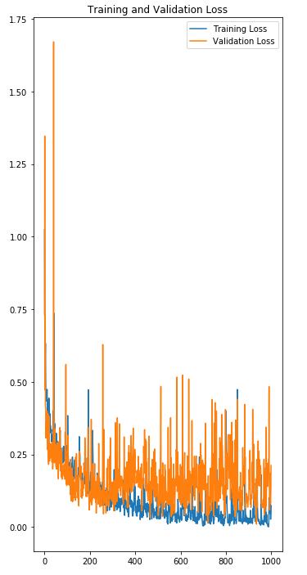
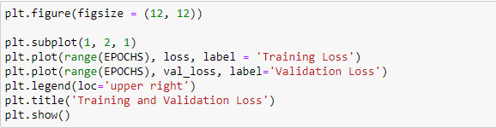
Loss
Same trend as seen in accuracy was followed in losses too, as we increased total number of epochs our losses reduced.

Slide 10
Interpretation of the Results
As we can see from the two graphs our training and validation accuracies showed a steep increment in early stages but later it slowed and was almost flat after 200 epochs. Similar was the case with the loss graph as we can see our losses decrease till around 200 epochs and then the graph straightened.

Slide 11
Conclusion
In this project we build a CNN model for detection of clothing items from the image dataset.
While collecting the data from the websites with the help of an automated browser using selenium, we learned how to download image data with the help of request and shuttle library.
We created a model which could help in identifying different clothing items with very high accuracy.

